Slide 1

Fuzzy Clustering
Rawan Sharef
Yousef Matar

Slide 2

Outline
unsupervised learning
Clustering in Machine Learning
Fuzzy Clustering
Applications in several fields of Fuzzy clustering
Advantages of Fuzzy Clustering
Disadvantages of Fuzzy Clustering
The Algorithm
The code

Slide 3
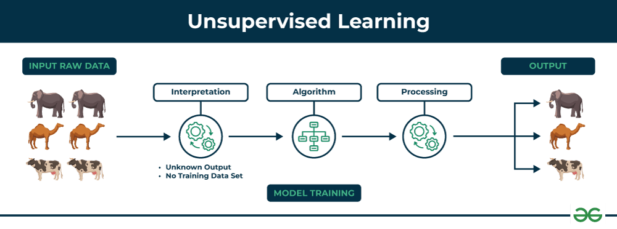
Unsupervised Learning
Unsupervised Learning is a type of machine learning where the model is trained on data that is not labeled, meaning the output (or target) is not provided. The goal of unsupervised learning is to discover underlying patterns, structures, or relationships in the data without predefined labels or categories.

Slide 4
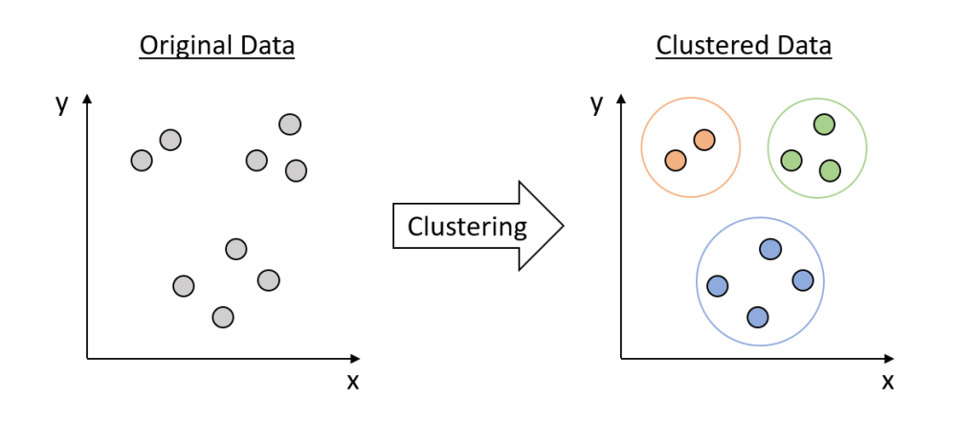
Clustering in Machine Learning
Clustering is an unsupervised machine learning technique that divides the given data into different clusters based on their distances (similarity) from each other.

Slide 5
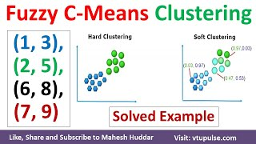
Fuzzy Clustering
The unsupervised k-means clustering algorithm gives the values of any point lying in some particular cluster to be either as 0 or 1 i.e., either true or false.
But the fuzzy logic gives the fuzzy values of any particular data point to be lying in either of the clusters.

Slide 6
Applications in several fields of Fuzzy clustering
Image segmentation
Pattern recognition
Marketing
Medical diagnosis
Environmental monitoring
Traffic flow analysis
Risk assessment

Slide 7
Advantages of Fuzzy Clustering
Flexibility: Fuzzy clustering allows for overlapping clusters, which can be useful when the data has a complex structure or when there are ambiguous or overlapping class boundaries.
Robustness: Fuzzy clustering can be more robust to outliers and noise in the data, as it allows for a more gradual transition from one cluster to another.
Interpretability: Fuzzy clustering provides a more nuanced understanding of the structure of the data, as it allows for a more detailed representation of the relationships between data points and clusters.

Slide 8
Disadvantages of Fuzzy Clustering
Complexity: Fuzzy clustering algorithms can be computationally more expensive than traditional clustering algorithms, as they require optimization over multiple membership degrees.
Model selection: Choosing the right number of clusters and membership functions can be challenging and may require expert knowledge or trial and error.

Slide 9

The steps to perform the algorithm

Slide 10
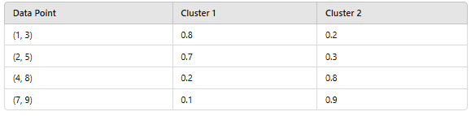
Step 1: Initialize the data points into the desired number of clusters randomly
Let us assume there are 2 clusters in which the data is to be divided, initializing the data point randomly. Each data point lies in both clusters with some membership value which can be assumed anything in the initial state.
The table below represents the values of the data points along with their membership (gamma) in each cluster.

Slide 11
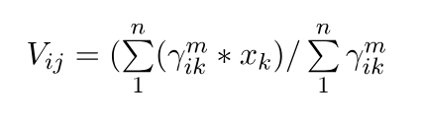
Step 2: Find out the centroid
Where:
µ - fuzzy membership value of the data point
m - the fuzziness parameter (generally taken as 2)
xk - the data point.
n- is the total number of data points.

Slide 12
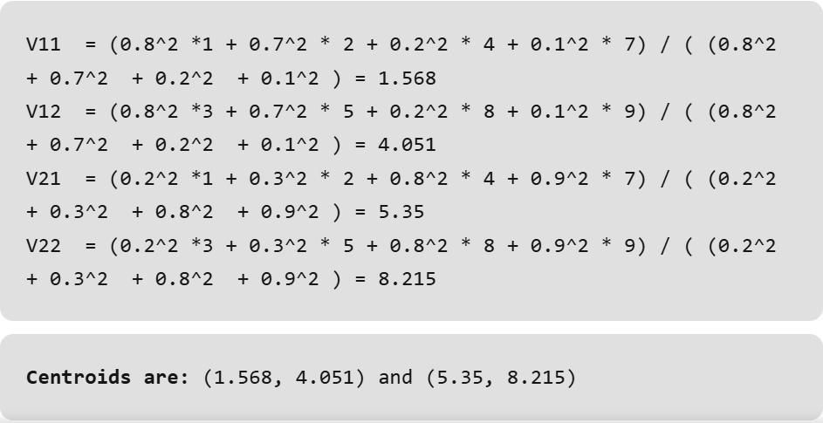

Slide 13
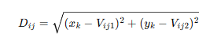
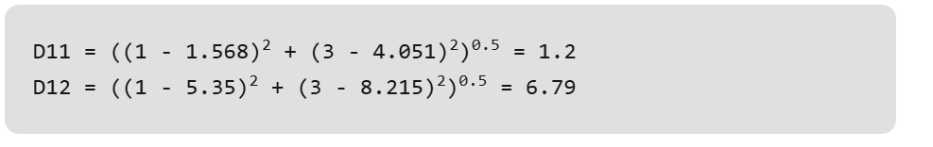
Step 3: Find out the distance of each point from the centroid.
Similarly, the distance of all other points is computed from both the centroids.

Slide 14
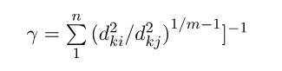
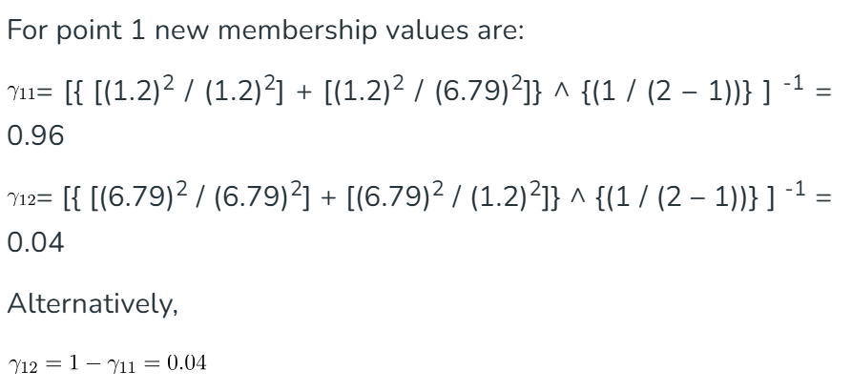
Step 4: Updating membership values.

Slide 15
Step 5:
Repeat the steps(2-4) until the constant values are obtained for the membership values or the difference is less than the tolerance value (a small value up to which the difference in values of two consequent updations is accepted).

Slide 16
Step 6: Defuzzify the obtained membership values.
Implementation: In this step, we look at the membership values' matrix, for each point "j", we check the row index "i" that has the biggest value, then we classify point "j" to be in cluster "i", thus the function F would behave as such:
F( point = "j" ) = (cluster = "i“)

Slide 17

The Code

